Slide 1





Mocking with Moq
Tools for Easier Unit Testing
High-Quality Code
SoftUni Team
Technical Trainers
Software University
http://softuni.bg

Slide 2

Table of Contents
Testable Code
Mocking
Moq

Slide 3
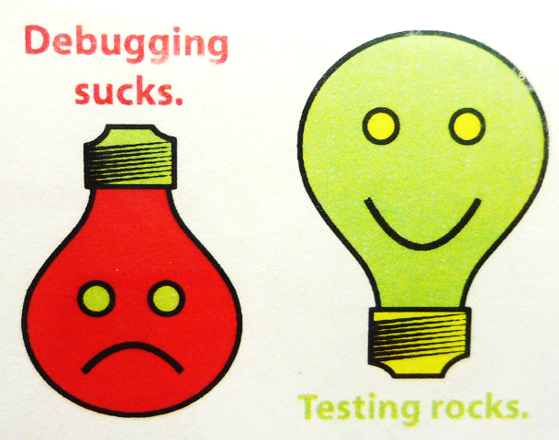
Testable Code

Slide 4
How to Write Testable Code
Inversion of Control Pattern
There is a decoupling of the execution of a certain task from implementation
Every module can focus on what it is designed for
Modules make no assumptions about what other systems do but rely on their contracts
Replacing modules has no side effect on other modules
More info at http://en.wikipedia.org/wiki/Inversion_of_control

Slide 5
How to Write Testable Code
The public API should work with interfaces, not implementation classes
For example, IEnumerable<T> vs. List<T>
Bad (untestable) code:
Good (testable) code:
public Card[] Cards { get; private set; }
public IList<ICard> Cards { get; private set; }

Slide 6
How to Write Testable Code
Dependency Injection
Ninject – http://www.ninject.org/
Consists of:
A dependent consumer
A declaration of a component's dependencies, defined as interface contracts
An injector (sometimes referred to as a provider or container) that creates instances of classes that implement a given dependency interface on request

Slide 7
How to Write Testable Code
Bad Example:
public interface IViewBase { … }
public interface IPresenterBase { … }
public class MemoryLayoutView : IViewBase { … }
public class MemoryLayoutPresenter : IPresenterBase
{
private MemoryLayoutView view;
public MemoryLayoutPresenter()
{
this.view = new MemoryLayoutView();
}
}

Slide 8
How to Write Testable Code
public interface IViewBase { … }
public interface IPresenterBase { … }
public class MemoryLayoutView : IViewBase { … }
public class MemoryLayoutPresenter : IPresenterBase
{
private IViewBase view;
public MemoryLayoutPresenter(IViewBase myView)
{
this.view = myView;
}
}
public class Program
{
static void Main()
{
InjectionContainer.Create<typeof(MemoryLayoutPresenter)>();
}
}

Slide 9

Mocking

Slide 10
Mocking
Makes unit testing more effective
Avoid writing boring boilerplate code
Isolate dependencies among units
Asserts expectations for code quality
E.g. checks that a method is called only once

Slide 11

Moq

Slide 12
Moq
Install from the NuGet package manager
Refer the library
Use its API
https://github.com/Moq/moq4
var mock = new Mock<ICarsRepository>();
mock.Setup(r => r.Add(It.IsAny<Car>())).Verifiable();
mock.Setup(r => r.All()).Returns(this.FakeCarCollection);

Slide 13
Moq
The most often used APIs:
.Setup()
.Verifiable()
.Callback()
.Returns()
.Throws()
It.Is<type>(x => condition)

Slide 14

Mocking
Live Demo

Slide 15

Mocking
Exercises in Class

Slide 16

Summary
Follow the Inversion of Control pattern to provide external dependencies
Use mocking when your code has external dependencies
A buggy dependence may cause a correct code to fail a unit test
Controversial points
Injecting dependencies vs. mocking
Mocking absolutely all dependencies

Slide 17









Mocking with Moq
http://softuni.org/courses/high-quality-code

Slide 18

License
This course (slides, examples, demos, videos, homework, etc.) is licensed under the "Creative Commons Attribution-NonCommercial-ShareAlike 4.0 International" license
Attribution: this work may contain portions from
"Fundamentals of Computer Programming with C#" book by Svetlin Nakov & Co. under CC-BY-SA license
"C# Part I" course by Telerik Academy under CC-BY-NC-SA license

Slide 19






Free Trainings @ Software University
Software University Foundation – softuni.org
Software University – High-Quality Education, Profession and Job for Software Developers
softuni.bg
Software University @ Facebook
facebook.com/SoftwareUniversity
Software University @ YouTube
youtube.com/SoftwareUniversity
Software University Forums – forum.softuni.bg

